Slide 1

Last review

Slide 2
Key lessons
Planning
Development
Final product presentation

Slide 3
Planning
Priorities currently requirement gathering.
Better high level planning.
Since low level design change frequently during development do not spend to much time of the design of it.
Plan your development with TDD guideline.
Use mockup.

Slide 4
Development
TDD
Develop as generic as you can.
Know your development tools.
Do not spend too much time on documentation it goes old to fast.

Slide 5
Final product
WCF web service
Data layer + main business logic
Can implement in many platform
Web application
Ext.Net application (Windows UI)
Can preform all the actions
Android application
Mainly a viewer (except registration)

Slide 6
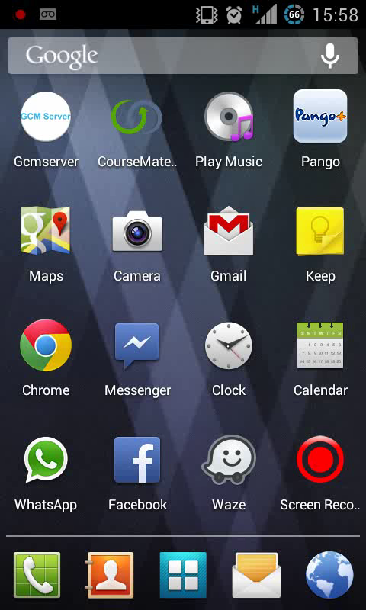

Android presentation

Slide 7
Website presentation

